Slide 1
Allsaints DATA TRACKING REFERENCE PHOTOS MOE

Slide 2
MONTHLY REPORT 2025
 | January | February | March | April | May | June | July | August | September | October | November | December
Actual AED
Benchmark AED
Growth %
Amount Growth AED

Slide 3
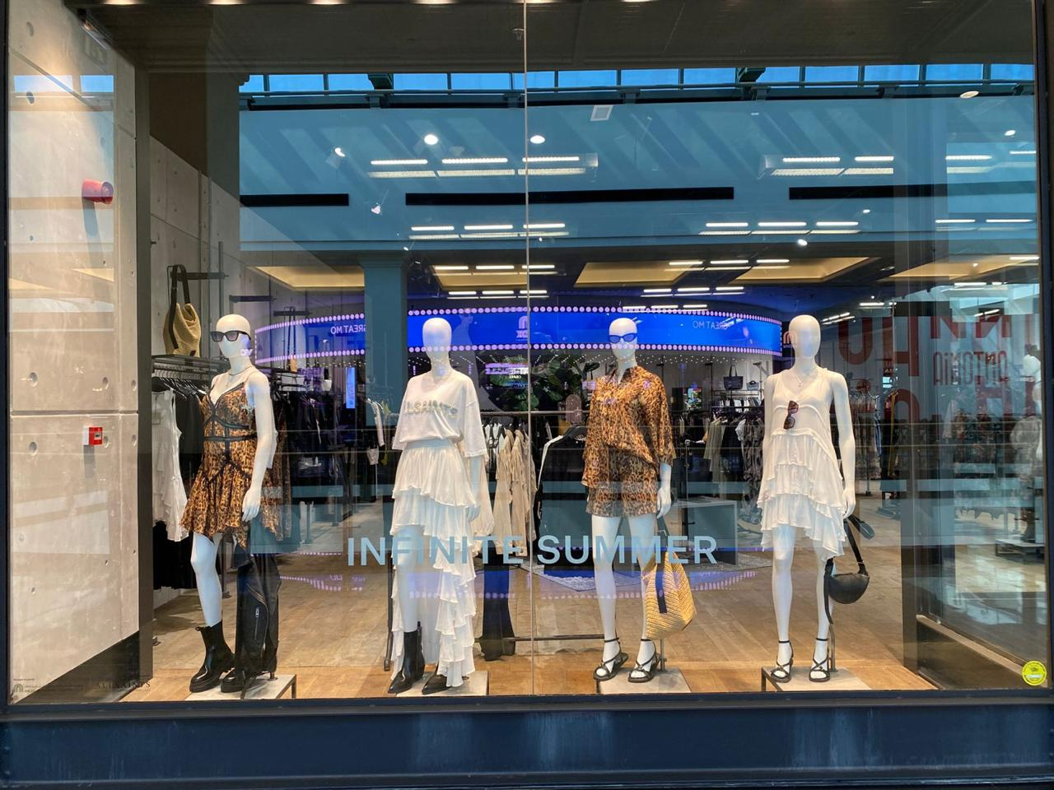
Womenswear.Follow the sun.Summer 2025.May Directive.
BRAND | ACTIVATION | DESCRIPTION | START DATE | END DATE | DURATION | UNITS SOLD | VALUE | BENCHMARK
AllSaints MOE | WINDOW | May directive | 5/13/2025 | 6/2/2025 | 19 days | 4 | 3,675

Slide 4
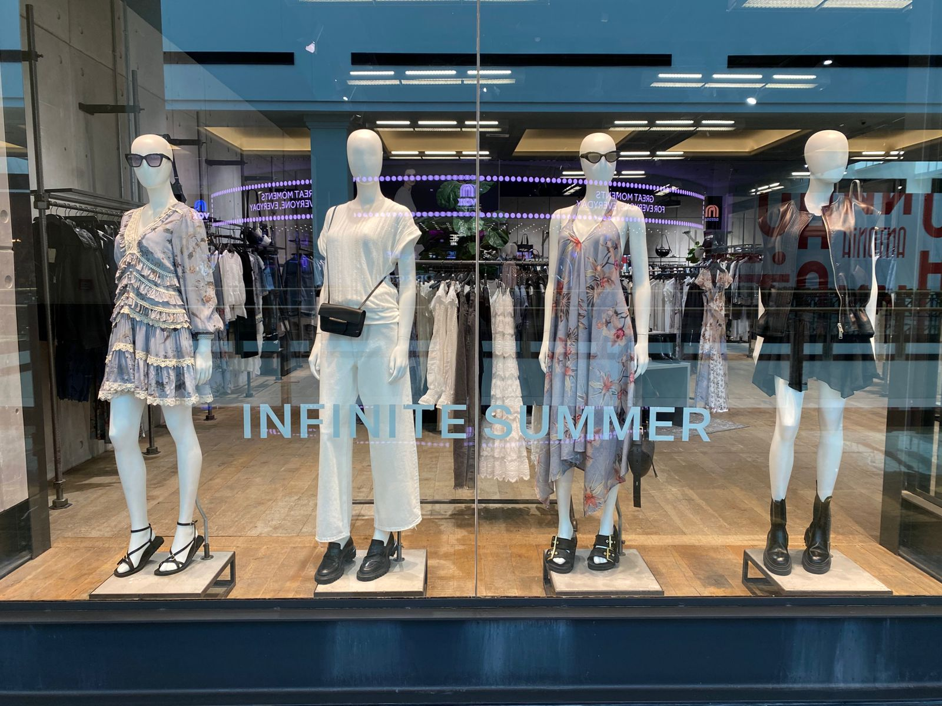
.
Womenswear.solstice sunset pt2.Summer 2025. June Directive.
BRAND | ACTIVATION | DESCRIPTION | START DATE | END DATE | DURATION | UNITS SOLD | VALUE | BENCHMARK
AllSaints MOE | WINDOW | Julne directive | 6/17/2025 | 7/2/2025 | 2 weeks | 12 | 8,100

Slide 5
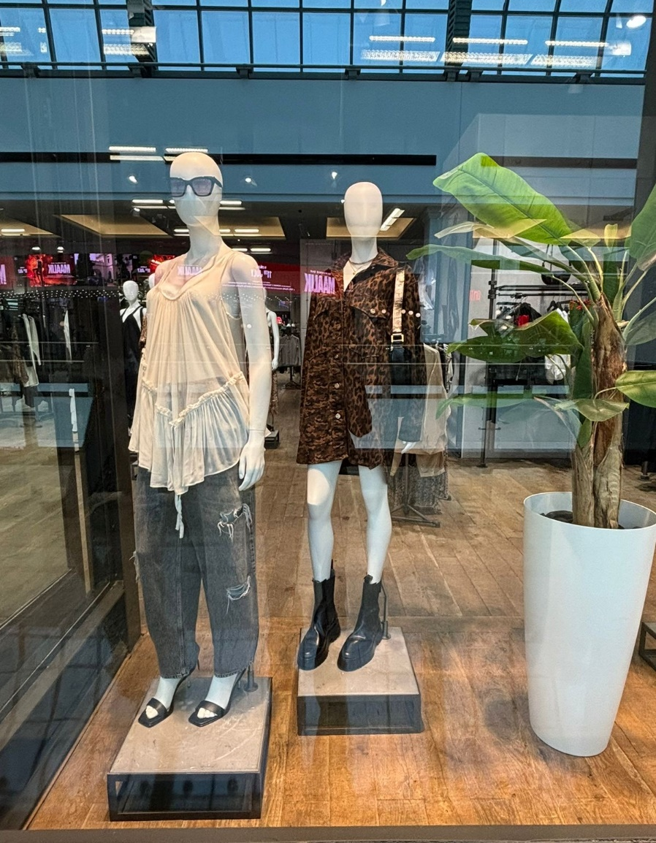
Womenswear.summer in the city .summer 2025 June directive.
BRAND | ACTIVATION | DESCRIPTION | START DATE | END DATE | DURATION | UNITS SOLD | VALUE | BENCHMARK
AllSaints MOE | WINDOW | Julne directive | 7/16/2025 | 7/28/2025 | 2 weeks | 4 | 3,435

Slide 6
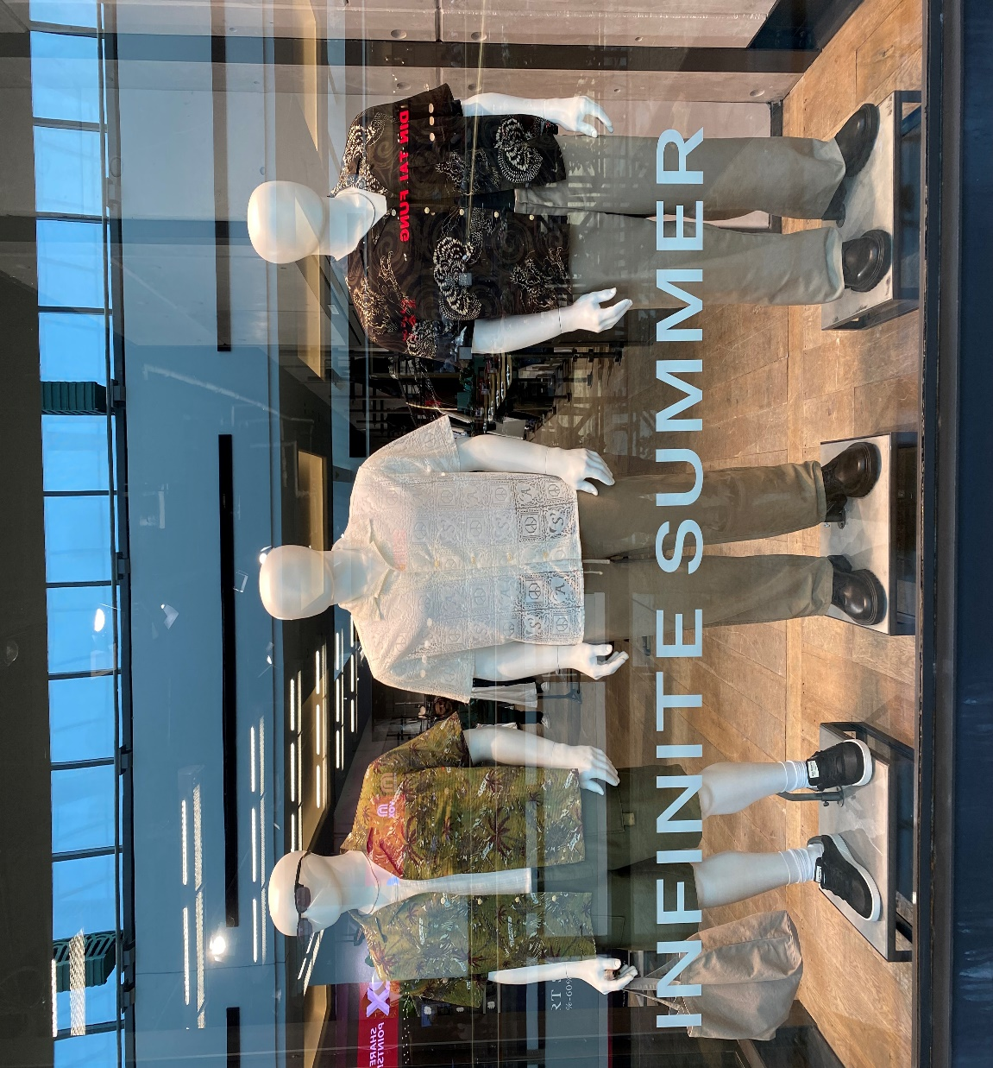
Menswear.On-sea.festival.summer 2025.June directive.
BRAND | ACTIVATION | DESCRIPTION | START DATE | END DATE | DURATION | UNITS SOLD | VALUE | BENCHMARK
AllSaints MOE | WINDOW | June directive | 06/26/2025 | 07/07/2024 | 2 weeks | 14 | 8,010

Slide 7
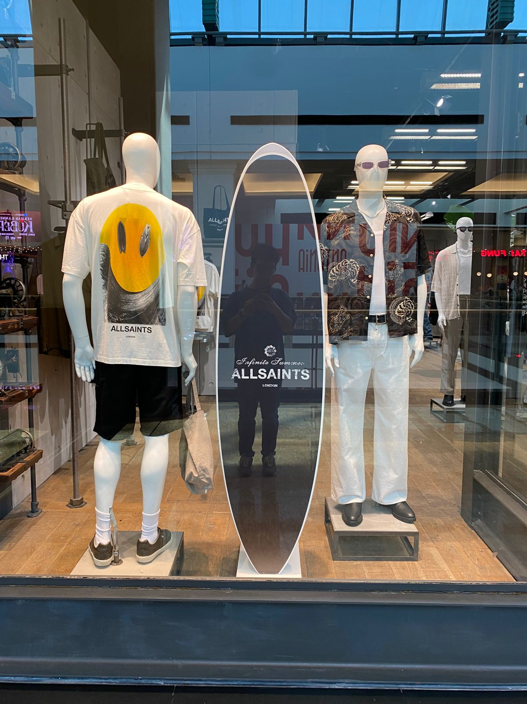
Menswear.On-sea.festival.summer 2025.June directive.
BRAND | ACTIVATION | DESCRIPTION | START DATE | END DATE | DURATION | UNITS SOLD | VALUE | BENCHMARK
AllSaints MOE | WINDOW | June directive | 06/26/2025 | 07/07/2024 | 2 weeks | 13 | 6,180

Slide 8
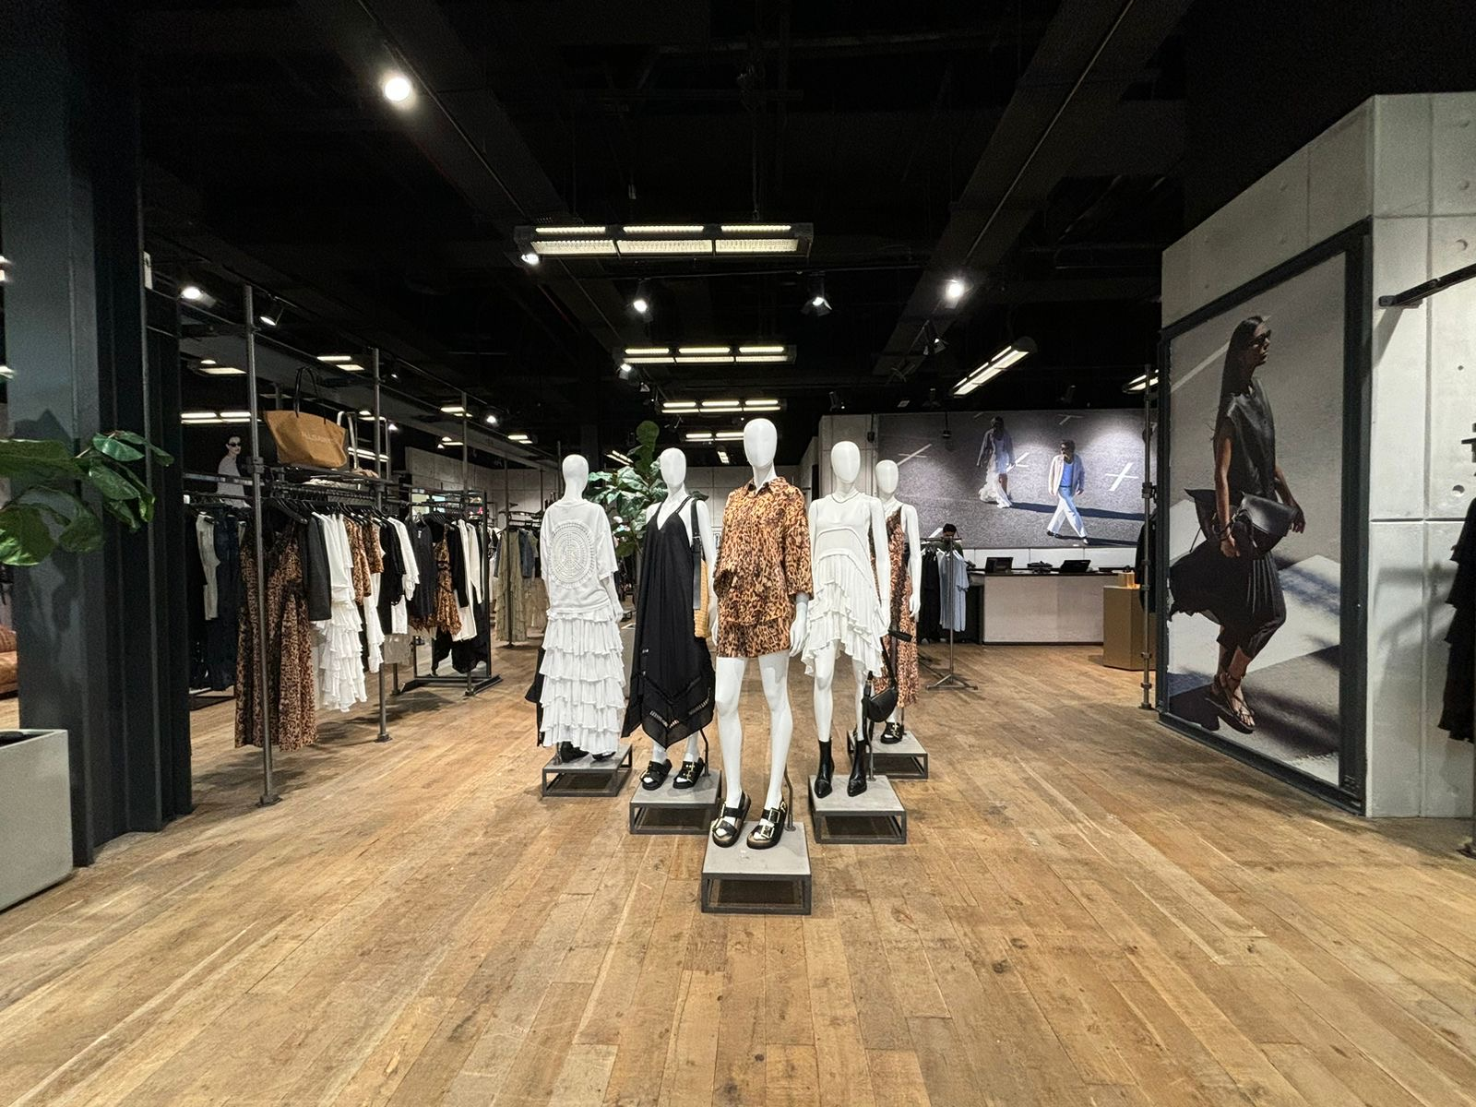
Womenswear.Summer in the city.summer 2025. June direct tive.
BRAND | ACTIVATION | DESCRIPTION | START DATE | END DATE | DURATION | UNITS SOLD | VALUE | BENCHMARK
AllSaints MOE | entrance | July directive | 7/12/2025 | 7/28/2025 | 16 days | 18 | 13,240

Slide 9
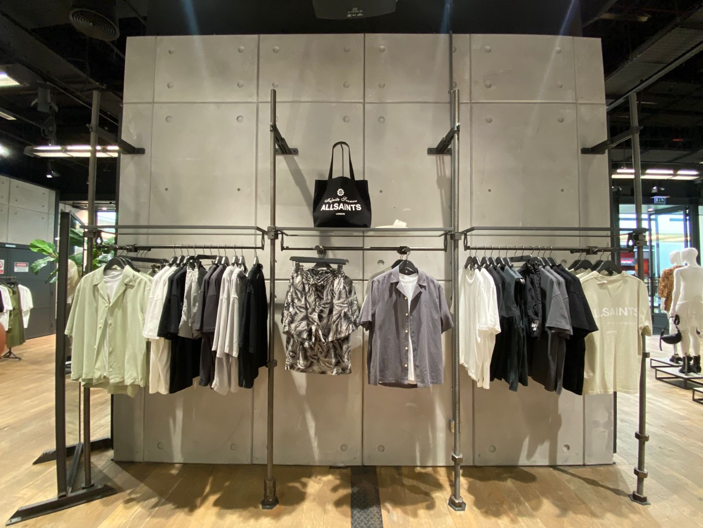
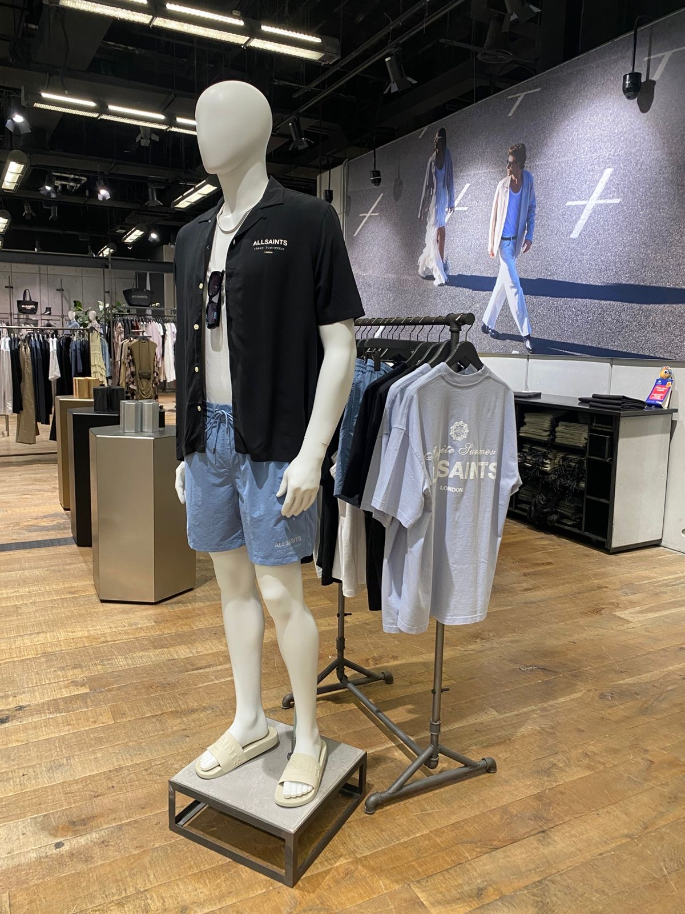
Menswear. Sweamwear initiative.summer july 2025.
BRAND | ACTIVATION | DESCRIPTION | START DATE | END DATE | DURATION | UNITS SOLD | VALUE | BENCHMARK
AllSaints MOE | Wall display | July summer 2025.iniative | 07/07/2025 | 7/17/2025 | 2 weeks | 104 | 41,892

Slide 10
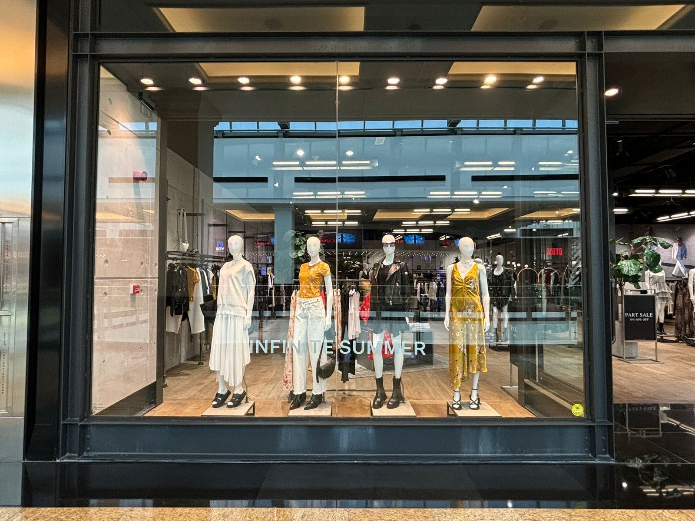
evolution of eden. parklife.
BRAND | ACTIVATION | DESCRIPTION | START DATE | END DATE | DURATION | UNITS SOLD | VALUE | BENCHMARK
AllSaints MOE | WINDOW | July directive | 7/28/2025 | 8/07/2024 | 11 days | 16 | 11,440

Slide 11
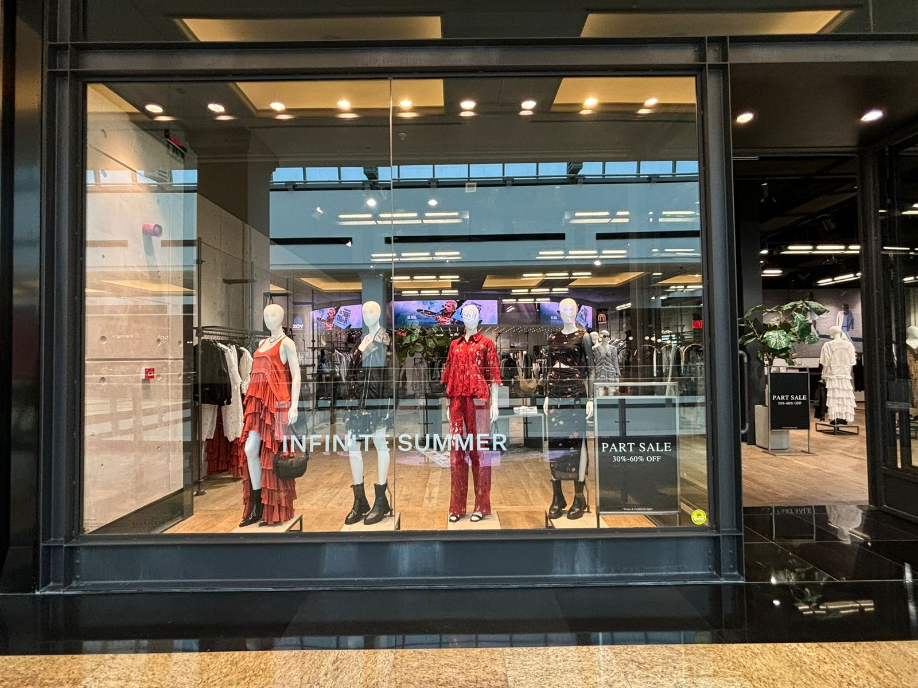
Womenswear.Reclaimed Eden.Summer 2025.July Directive
BRAND | ACTIVATION | DESCRIPTION | START DATE | END DATE | DURATION | UNITS SOLD | VALUE | BENCHMARK
AllSaints MOE | WINDOW | July directive | 07/28/2025 | 08/17/2024 | 10 | 9,970

Slide 12
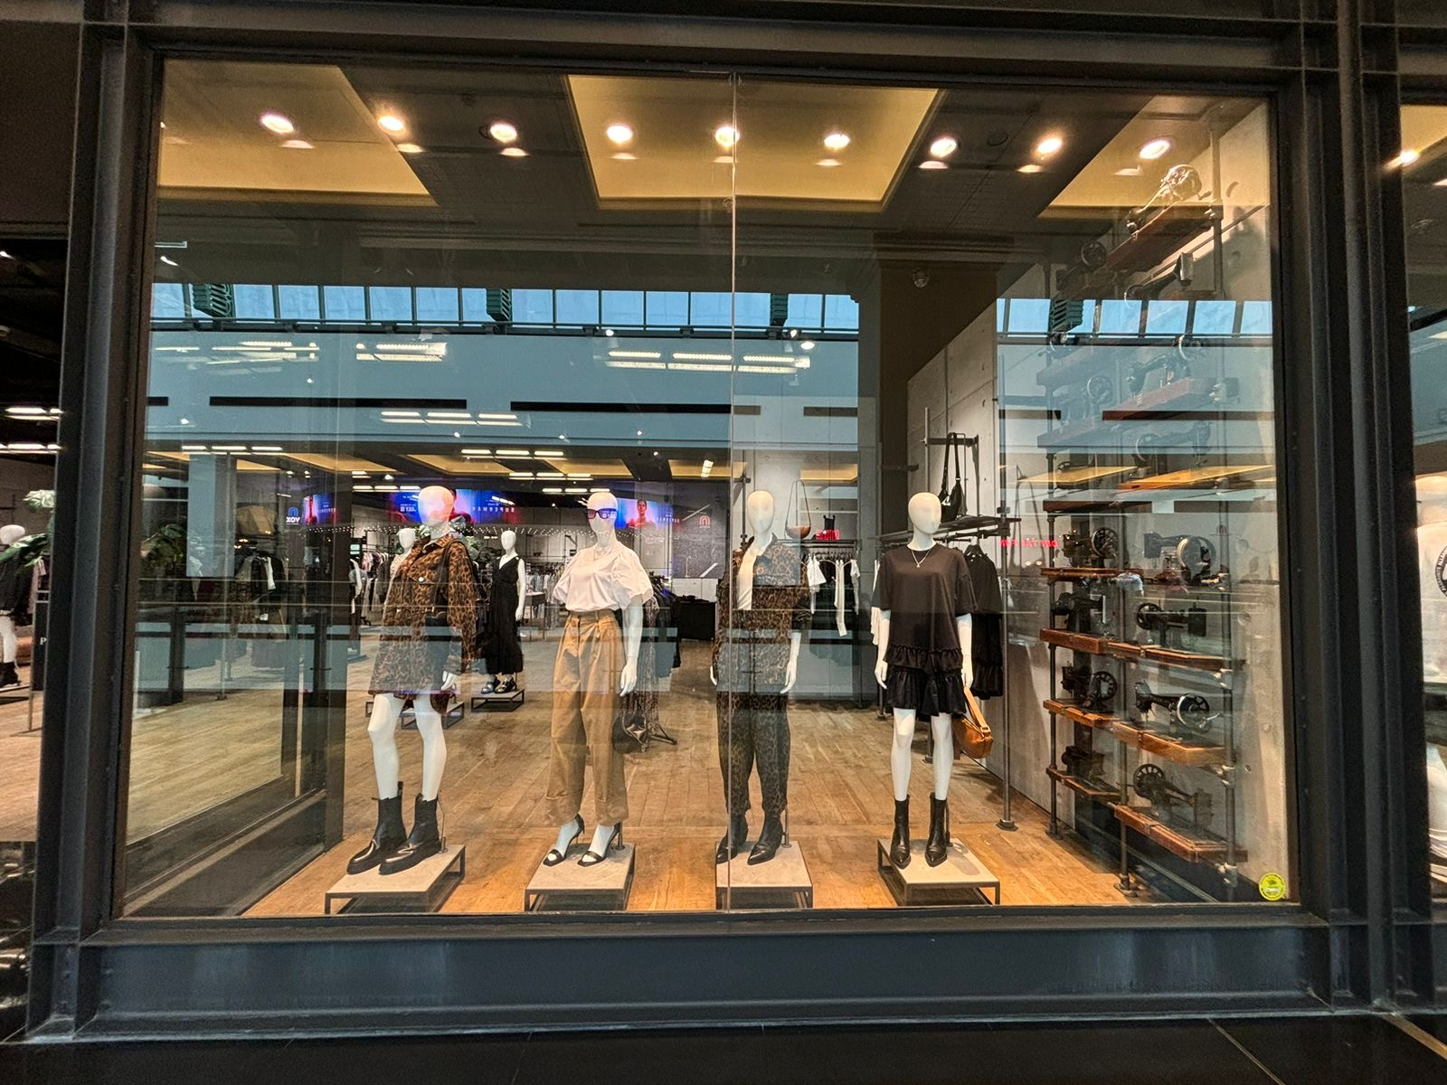
Womenswear.Reclaimed Eden.Summer 2025.July Directive
BRAND | ACTIVATION | DESCRIPTION | START DATE | END DATE | DURATION | UNITS SOLD | VALUE | BENCHMARK
AllSaints MOE | WINDOW | July directive | 07/28/2025 | 08/17/2024 | 12 | 12,815

Slide 13
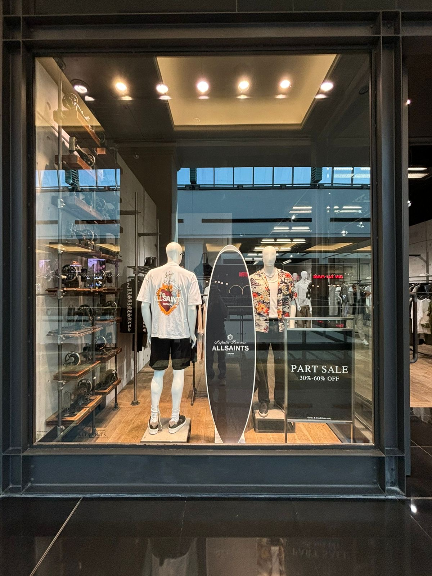
Menswear.villa nellcote.summer in the sea.Summer 2025 July Directive.
BRAND | ACTIVATION | DESCRIPTION | START DATE | END DATE | DURATION | UNITS SOLD | VALUE | BENCHMARK
AllSaints MOE | WINDOW | July directive | 07/28/2025 | 08/07/202 | 2 weeks | 43 | 14,350

Slide 14
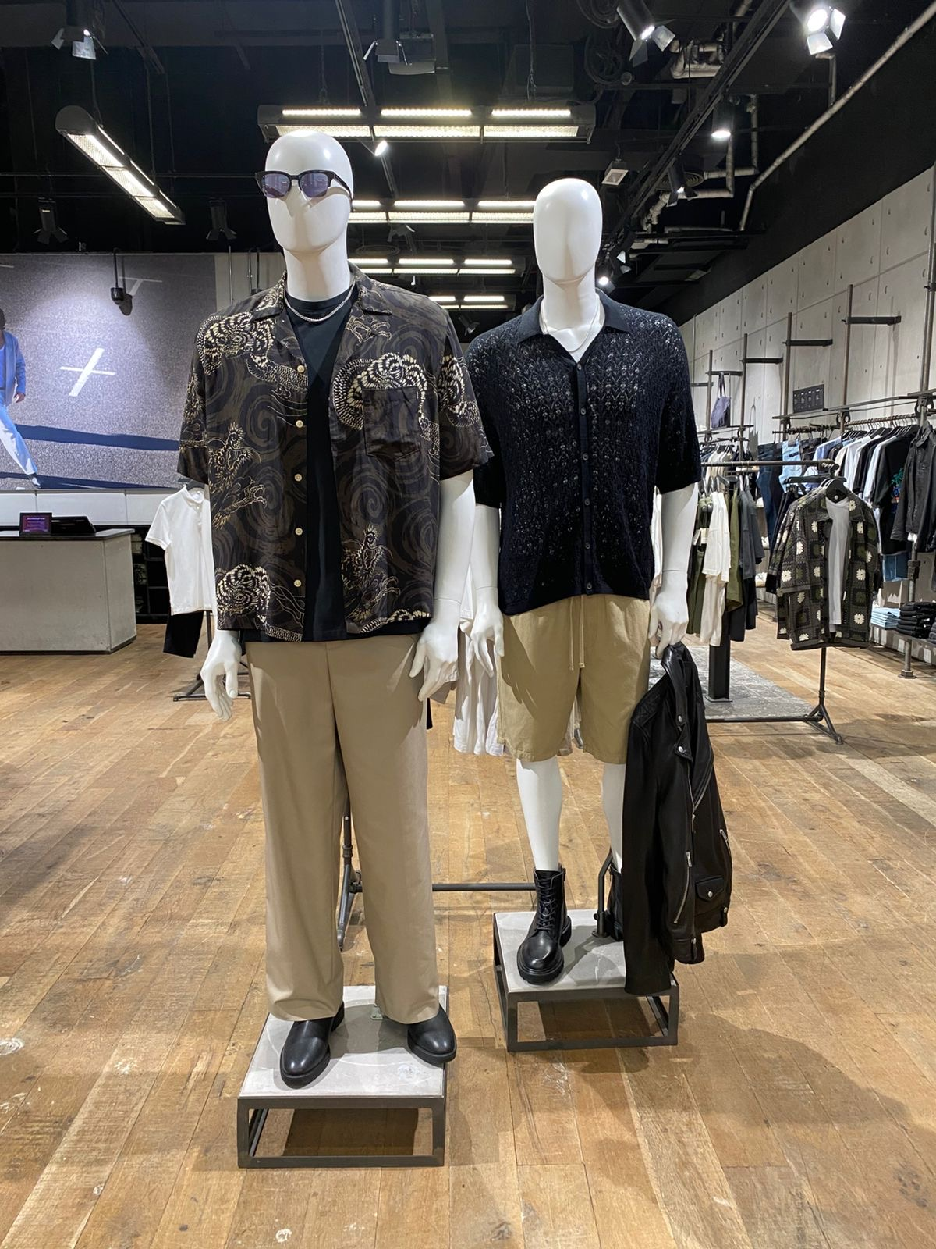
Menswear. Leather destination. Autumn 2025 August Directive.
BRAND | ACTIVATION | DESCRIPTION | START DATE | END DATE | DURATION | UNITS SOLD | VALUE | BENCHMARK
AllSaints MOE | Slow seller | August directive | 08/20/2025 | 09/01/2025 | 2 weeks | 8 | 2,720

Slide 15
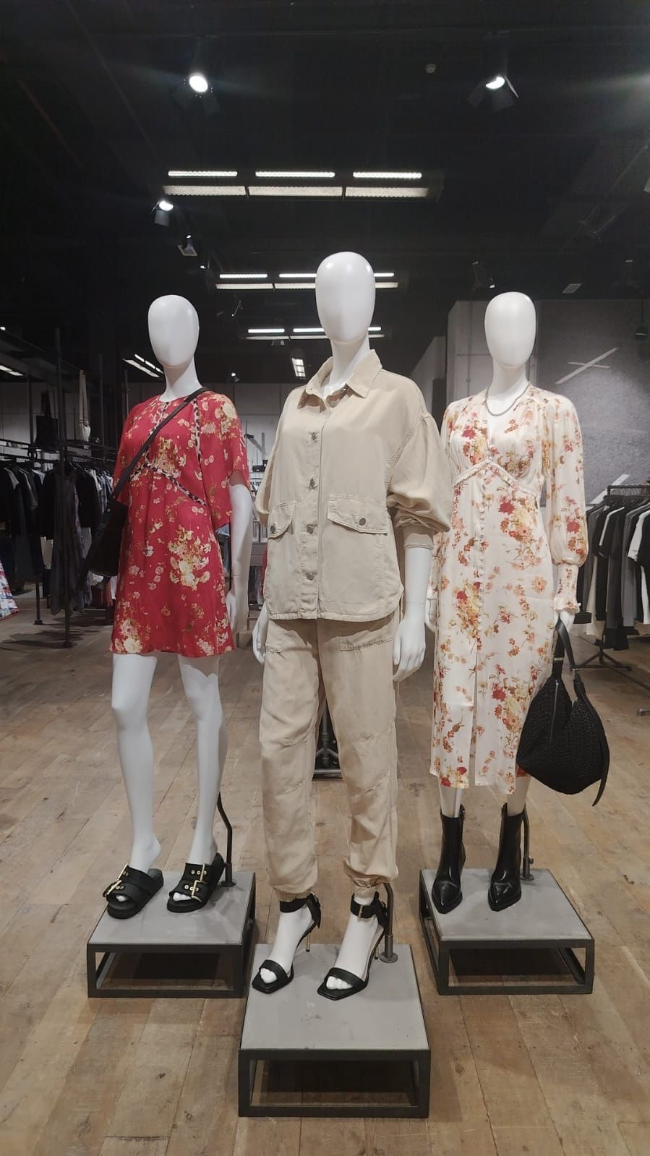
Womenswear.Reclaim Eden.Autumn 2025 August Directive.
BRAND | ACTIVATION | DESCRIPTION | START DATE | END DATE | DURATION | UNITS SOLD | VALUE | BENCHMARK
AllSaints MOE | Instore Mannequine | August directive | 08/07/2025 | 08/28/2025 | 26 days | 11 | 8,845

Slide 16
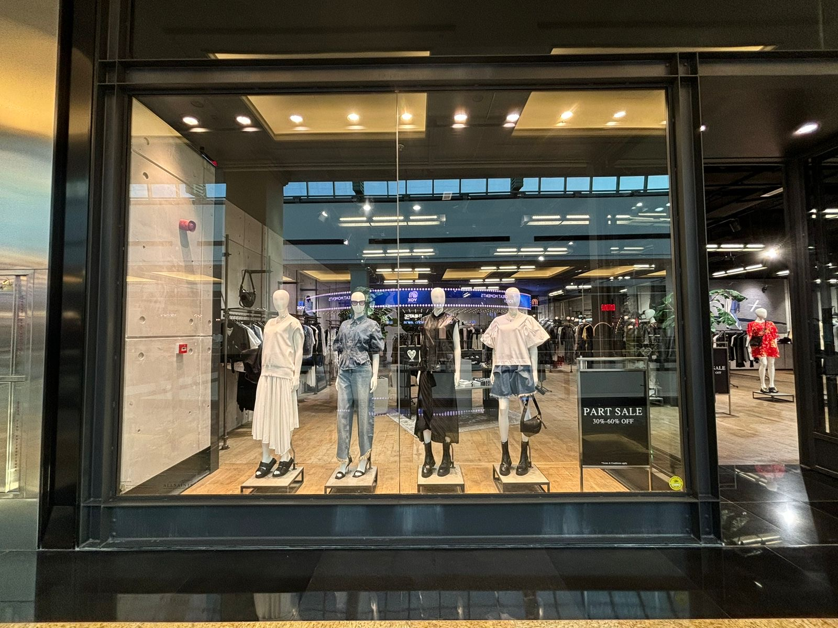
Womensweear.Reclaim Eden.Autumn 2025.August Directive.
BRAND | ACTIVATION | DESCRIPTION | START DATE | END DATE | DURATION | UNITS SOLD | VALUE | BENCHMARK
AllSaints MOE | WINDOW | August directive | 08/08/2025 | 9/6/2025 | 2 weekas | 4 | 3,675

Slide 17
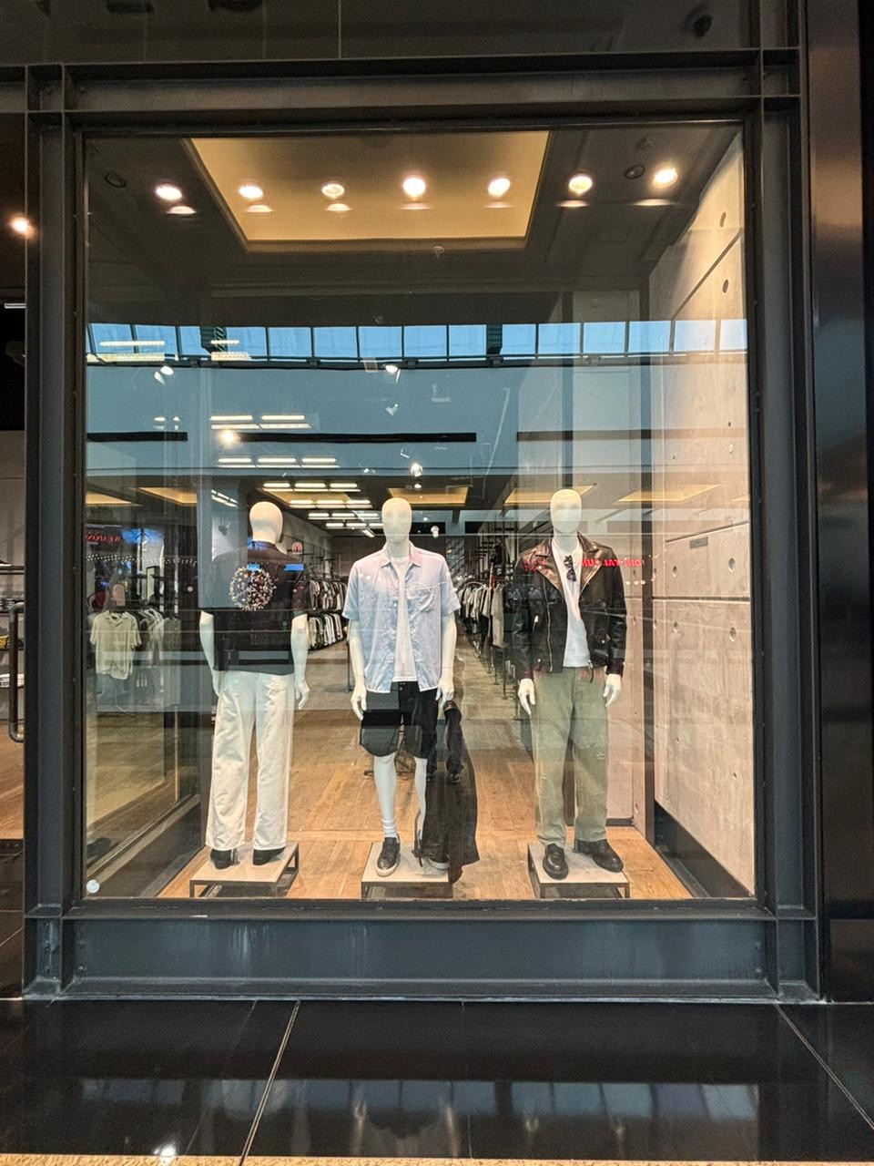
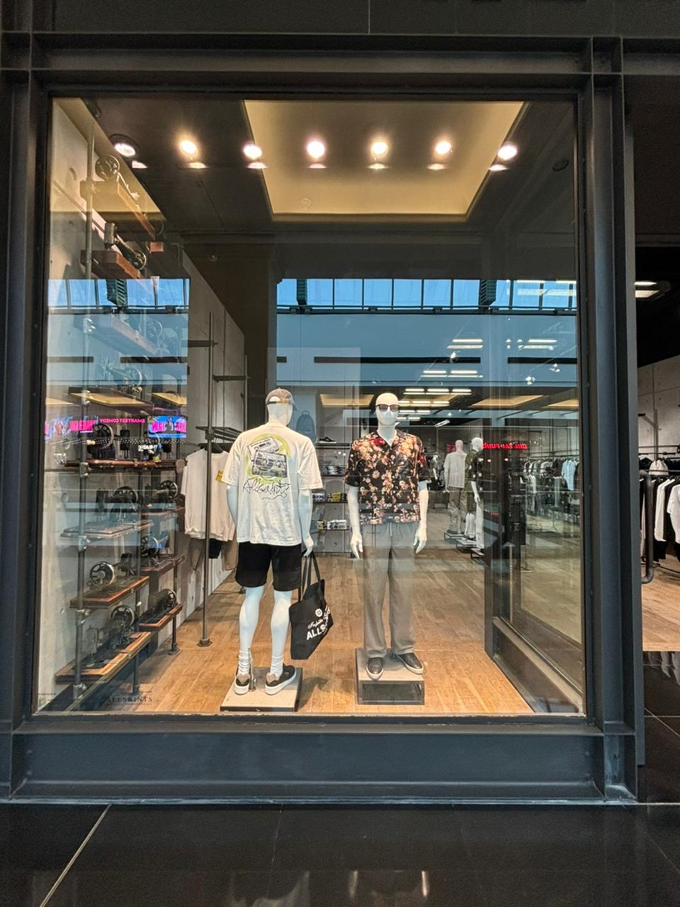
Menswear.united kingdom.Autumn 2025.August 2025
BRAND | ACTIVATION | DESCRIPTION | START DATE | END DATE | DURATION | UNITS SOLD | VALUE | BENCHMARK
AllSaints MOE | WINDOW | August directive | 08/08/2025 | 08/20/2025 | 2 weeks | 15 | 7,315

Slide 18
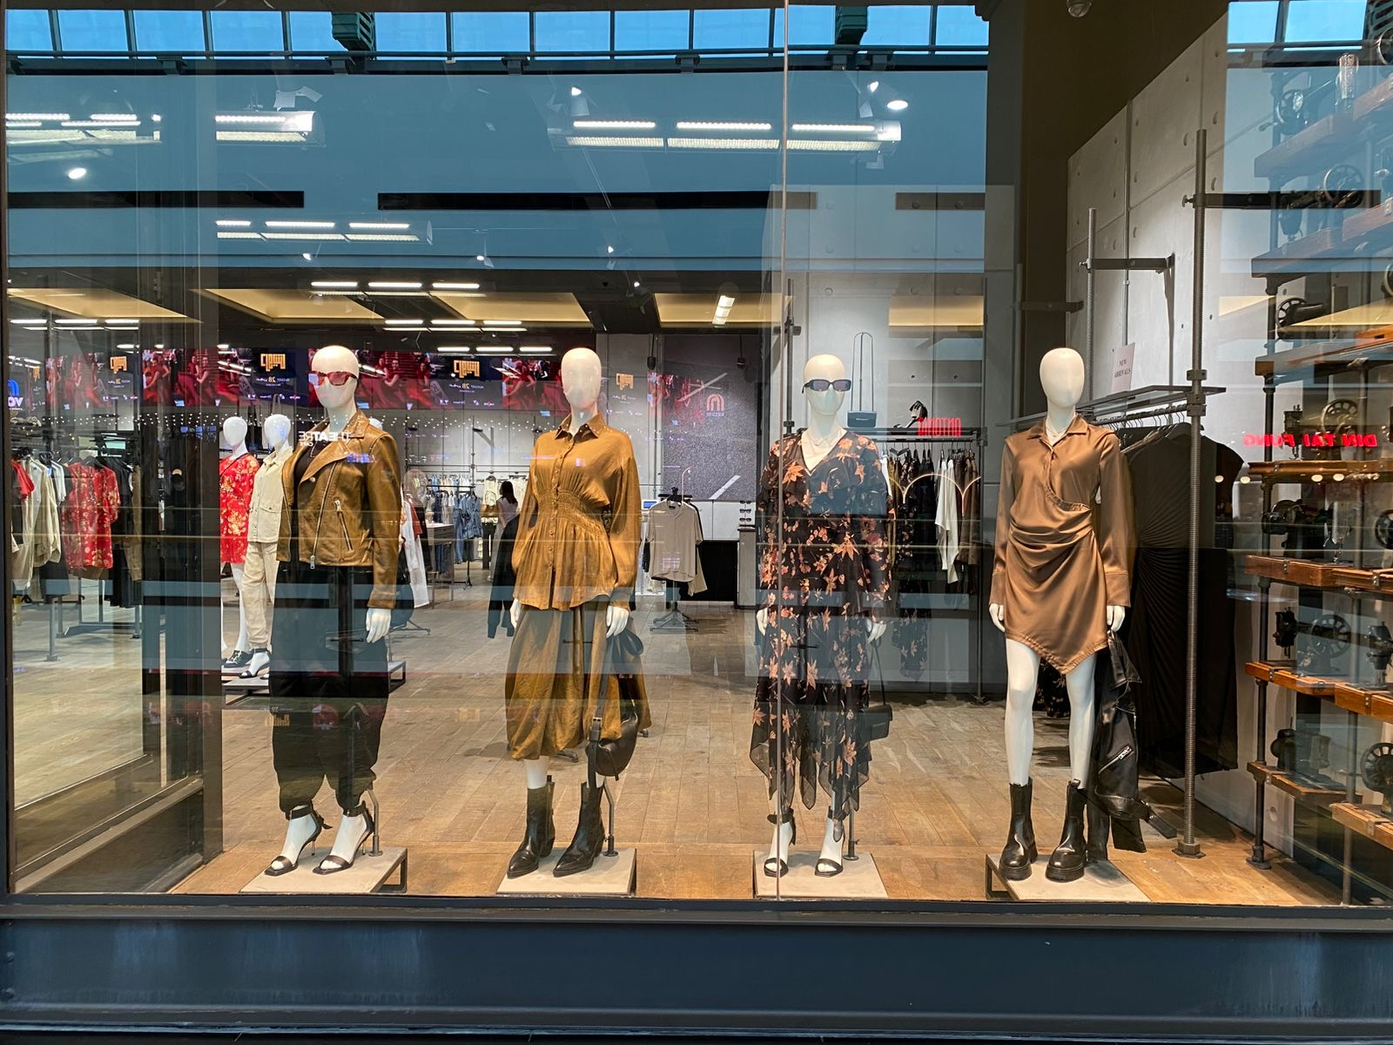
Womenswear.Reclaimed Eden.Autumn 2025.August Directive.
BRAND | ACTIVATION | DESCRIPTION | START DATE | END DATE | DURATION | UNITS SOLD | VALUE | BENCHMARK
AllSaints MOE | WINDOW | August directive | 08/20/2025 | 09/01/2025 | 2 weeks | 8 | 6,235

Slide 19
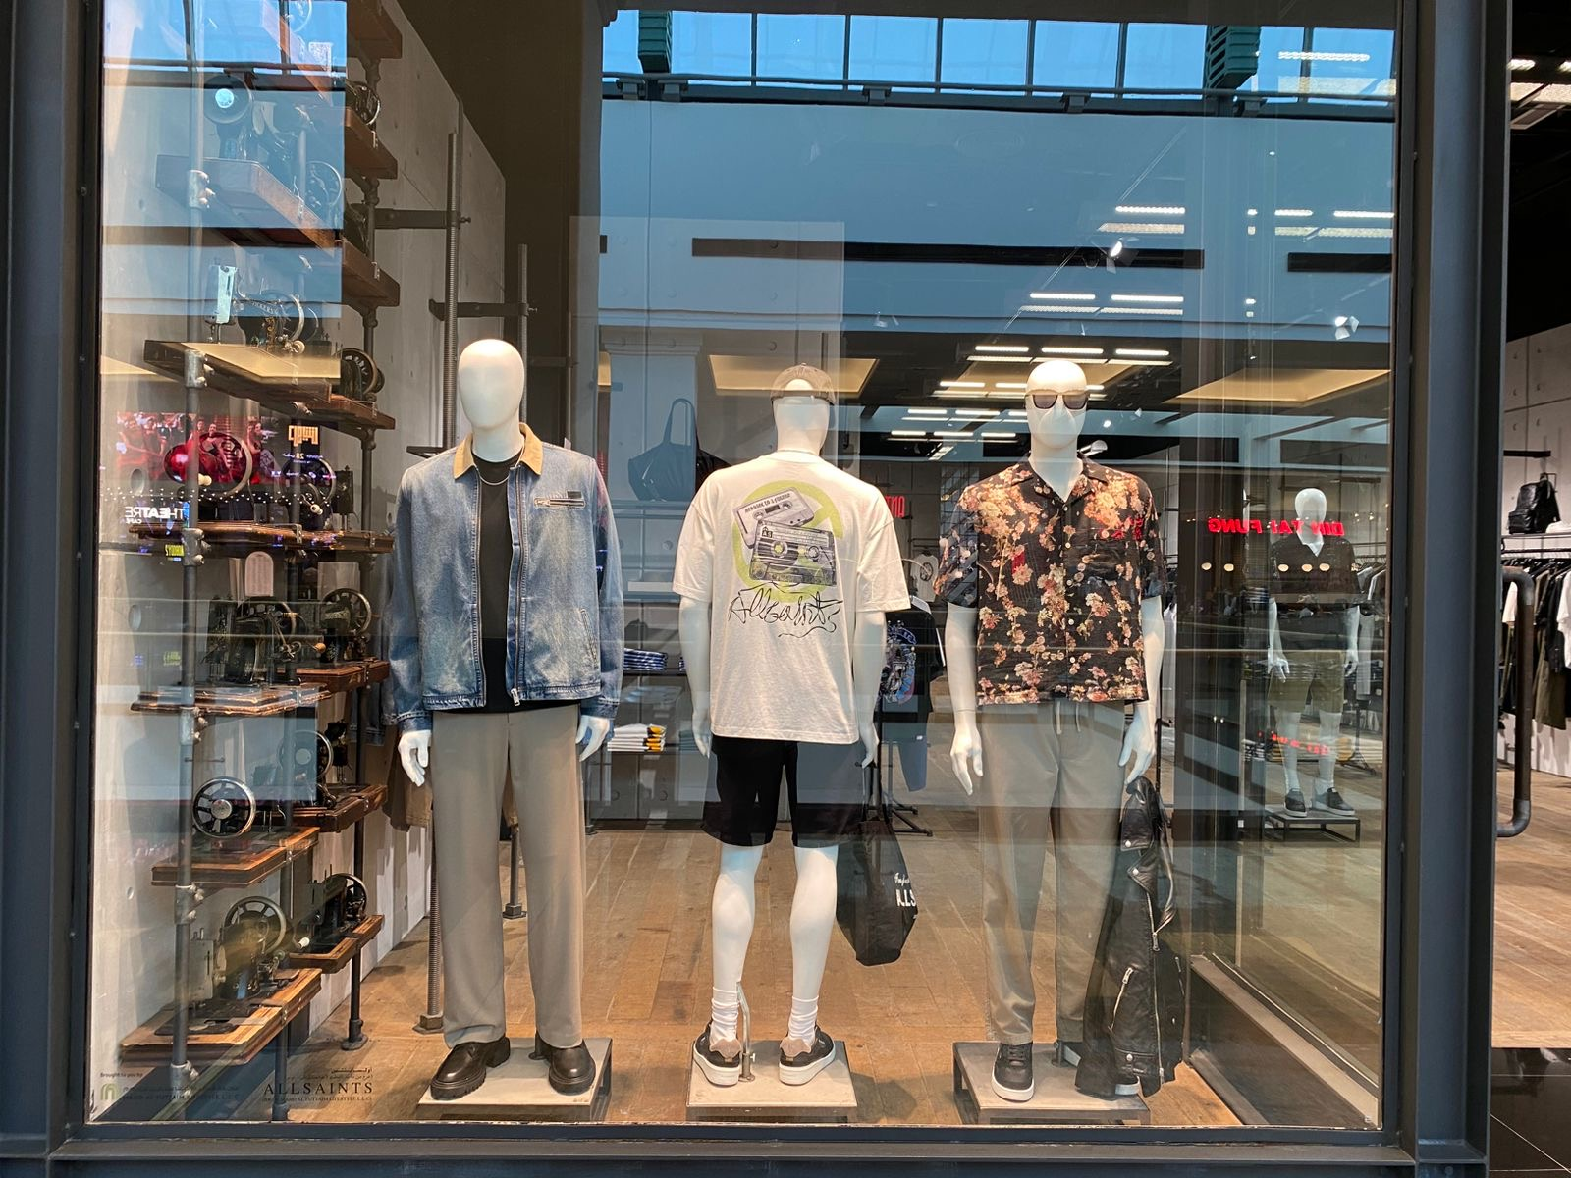
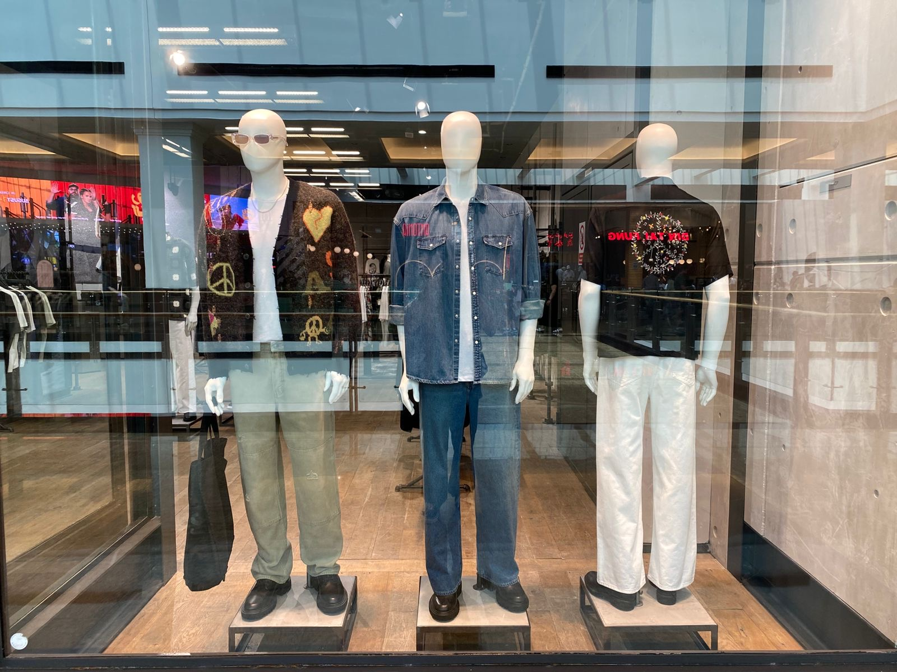
Menswear.United kingdom.Last BBQ of the year.Autumn 2025.August DIRECTIVE
BRAND | ACTIVATION | DESCRIPTION | START DATE | END DATE | DURATION | UNITS SOLD | VALUE | BENCHMARK
AllSaints MOE | WINDOW | August directive | 08/20/2025 | 09/01/2025 | 2 weeks | 16 | 10,255

